Slide 1
The void for quantitative social science teaching: is sharing OER enough?
‘We become aware of the void as we fill it’ (Portia, 1885). Discuss in the context of OER
Jackie Carter (@JackieCarter) and Jen Buckley, University of Manchester

Slide 2
What’s the problem?
It is also a problem for the graduates themselves. … the ability to "interpret and respond to quantitative data" is a core skill for the workplace and two-thirds of its [the CBI] members are concerned about their employees' inability to spot basic data errors. As our graduates compete in an increasingly challenging and international labour market, they must have the skills to succeed.
www.timeshighereducation.co.uk/421512.article

Slide 3
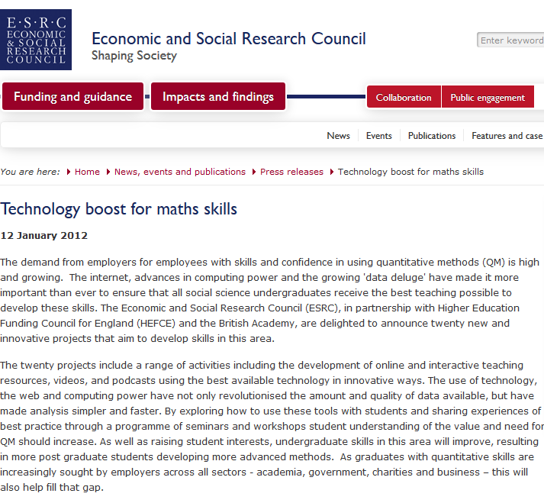
Economic and Social Research Council and British Academy – Quantitative Methods
involved, funders etc
20 projects, 2012 – 2015
Follows the MacInnes Report (2009)
University of Manchester: ESSTED Enriching Social Science Teaching with Empirical Data
Two strands – Curriculum Innovation and Researcher Developer Initiative
Innovative teaching and resources
Sharing best practice

Slide 4
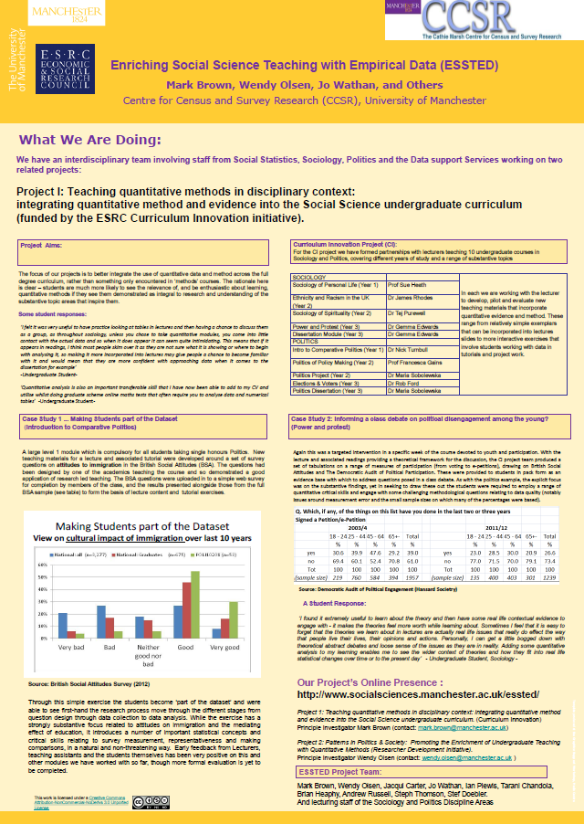
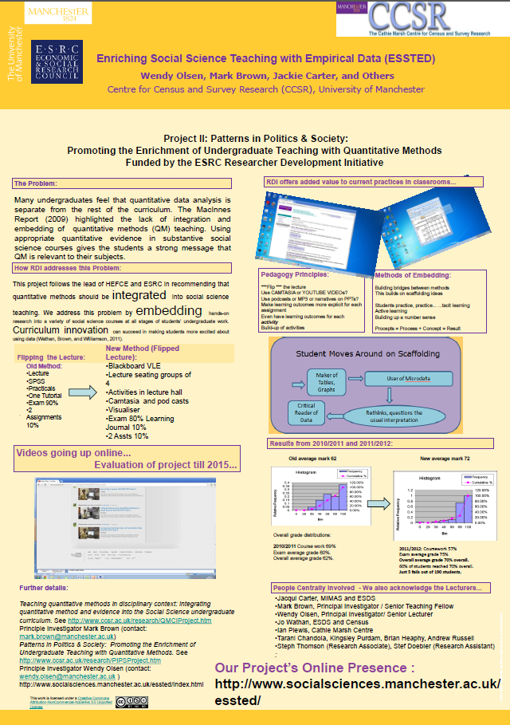

Slide 5
ESSTED - Open Educational Resources
Resources available through project
Currently in Wordpress
patternsinpoliticsandsociety.wordpress.com
Moving towards permanent institutional website by summer
Also will use Jorum

Slide 6
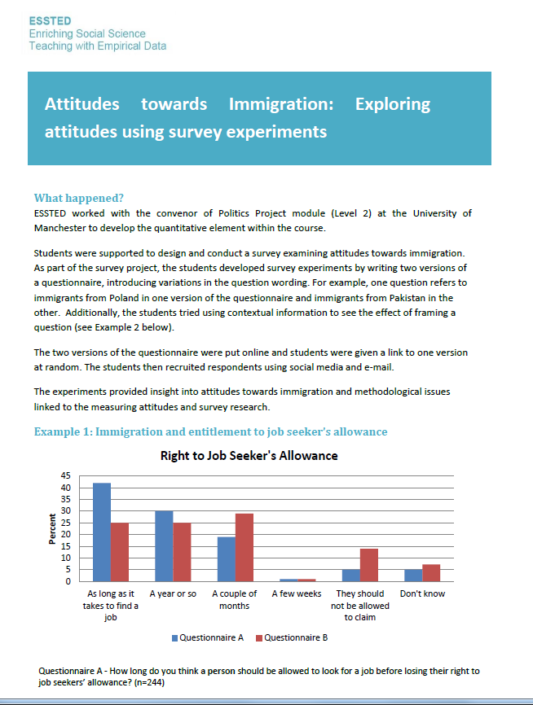
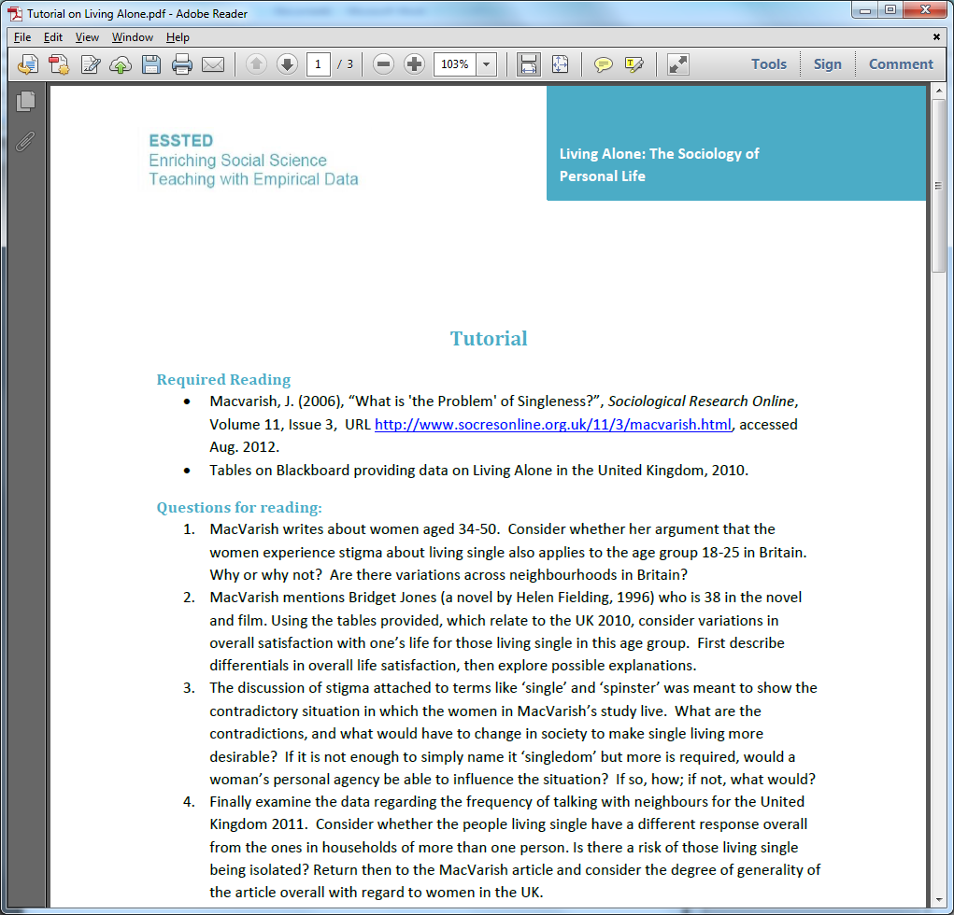
ESSTED - Open Educational Resources
What can we share?
Case Studies and access to our materials
Briefing papers
Creative Commons CC-BY-SA so teachers can use and adapt

Slide 7
ESSTED - sharing good practice
More that just resources…
Teaching ideas
What's available for teachers such as easily accessible data
Partnership working
Curriculum innovation
Value of peer to peer exchanges
Workshops
Briefing Papers
Webinars?
Videos
How?

Slide 8
ESSTED – evaluation
Baseline
ESSTED Modules
Dissemination
Inform Q-Step and wider initiatives
Student survey
Lecturer survey
Workshop discussions (informal)
Student survey + focus groups
Interviews with module convenors
Briefing papers
Workshops
Academic papers
Lectureships
Internships

Slide 9
Q-Step

Slide 10
Q-Step Centre at the University of Manchester

Slide 11
Q-Step summer 2014 projects
20 projects in various organisations
6-12 weeks long; generous stipends
Various quantitative skills required and to be developed
Real world data, real world research and applications
Sociology, politics, criminology, linguistics
Students will produce (at least) a poster to share their experiences
Will eventually include international projects with World Bank, OECD and IMF

Slide 12
Is sharing OER enough?
OER are a starting point
Sharing good practice is important
Being ‘in this together’
Policy and practice need to align
Collaborate to compete conundrum
Real world (open) data and skills
Necessary but not sufficient
Although time consuming, but of great value
And not reinventing wheels
A good evidence base needed
‘Twas ever thus?
Major benefits to be had from sharing practice – need more stories and numbers esp. from students and employers

Slide 13
Acknowledgments
ESSTED Team: Mark Brown, Wendy Olsen, Stephanie Thomson (former), Jo Wathan, and academics from Politics and Sociology at University of Manchester
www.socialsciences.manchester.ac.uk/research/research-centres-and-networks/essted/our-people
University of Manchester Q-Step team
www.manchester.ac.uk/q-step/our-people/
Funders: ESRC, British Academy, Hefce and Nuffield Foundation

Slide 14
Questions?

